Slide 1
Google Play™ Store Analysis
Kyle Peterson and Mark Peterson

Slide 2
Our Questions
What age-group has the most activity on Google Play™?
Are free apps more popular than paid ones? If so, how much more popular?
How common are positive reviews on apps?
Does file size have an affect on how many people download an app?
Are people more likely to leave a negative review on an app they’ve paid for?
Which genre has the most/least apps?
Which genre is the most popular?
Which genre is the most/least successful?

Slide 3
Our Questions (Cont.)
What is the most common rating score?
How many installs did each category get on average per app?
What is the average kilobyte size per app in each category?
In each category, what is the average rating per app?
How many reviews did each category receive on average per app?

Slide 4
The Data We’re Working With
Over 10,000 data entries on multiple Google Play™ apps
Source: Kaggle.com user Lavanya Gupta
Information used: App names, categories, ratings, numbers of reviews, file sizes, numbers of installs, payment types, prices, and maturity ratings

Slide 5
Cleaning The Data
Dropped additional columns of information we wouldn’t be using, such as update versions for each app
Dropped 1,475 rows of data which were lacking information
Dropped 1,640 rows of data with information not applicable to our tests, such as apps with file sizes that vary by device
Dropped 700 rows which contained duplicate information
Left with 7,026 rows of data after cleanup

Slide 6
Answering Our Questions

Slide 7
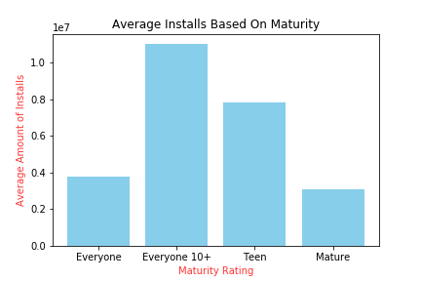
What age-group has the most activity on Google Play™?

Slide 8
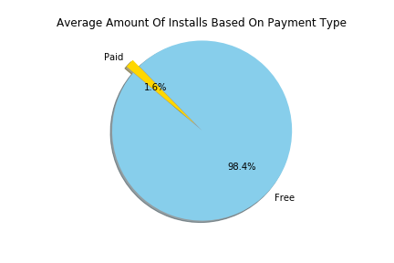
Are free apps more popular than paid ones? If so, how much more popular?

Slide 9
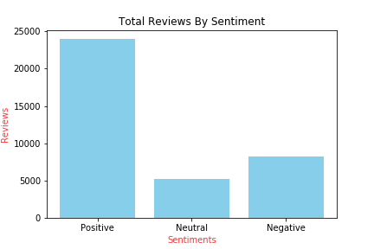
How common are positive reviews on apps?

Slide 10
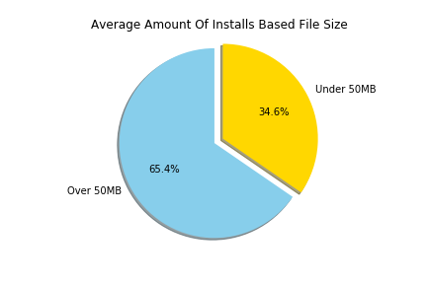
Does file size have an affect on how many people download an app?

Slide 11
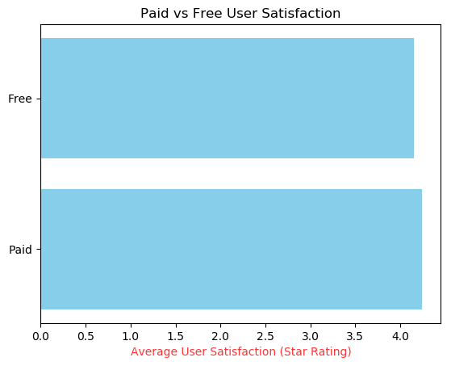
Are people more likely to leave a negative review on an app they’ve paid for?

Slide 12
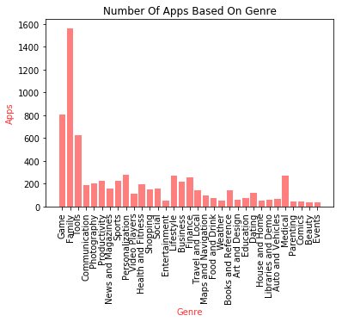
Which genre has the most/least apps?

Slide 13
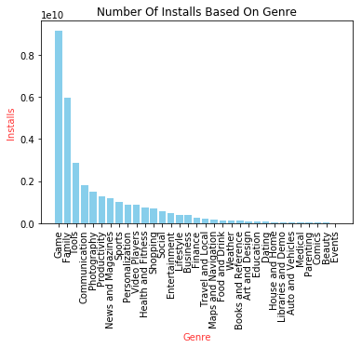
Which genre is the most popular?

Slide 14
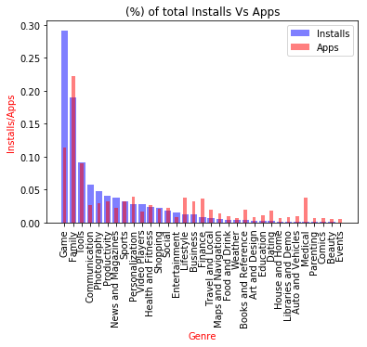
Which genre is the most/least successful?

Slide 15
Answering Our Questions (Cont.)

Slide 16
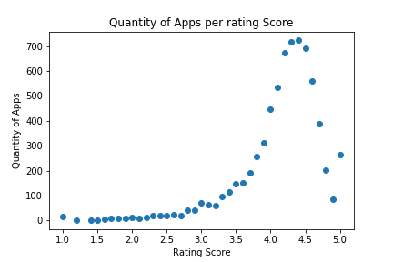
What is the most common rating score?

Slide 17
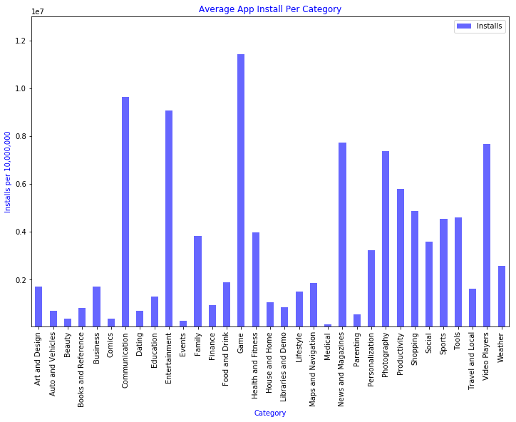
How many installs did each category get on average per app?

Slide 18
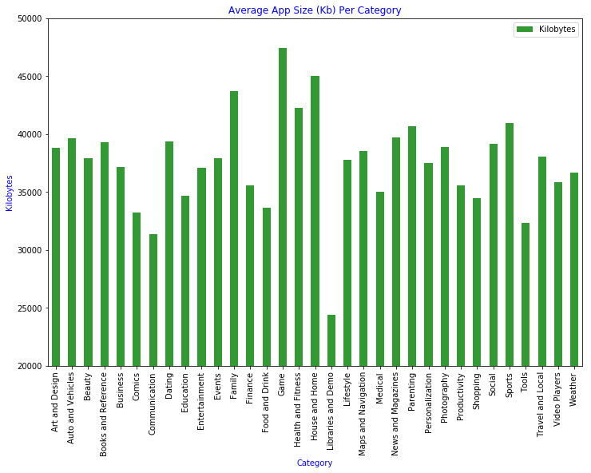
What is the average kilobyte size per app in each category?

Slide 19
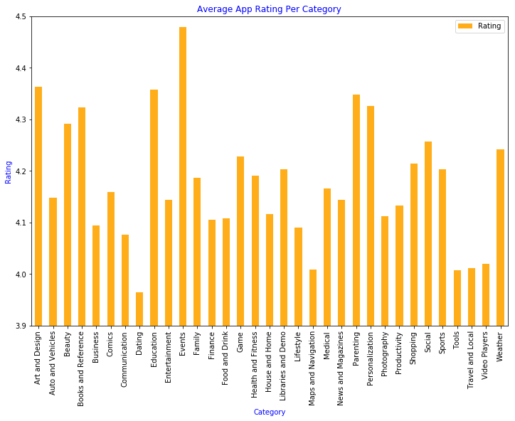
In each category, what is the average rating per app?

Slide 20
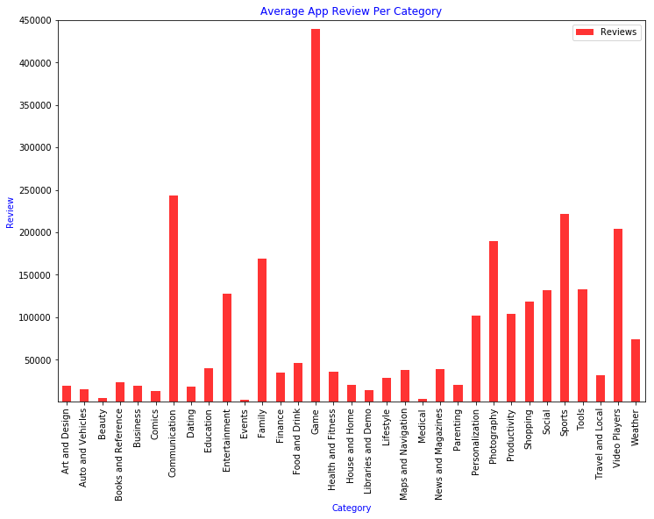
How many reviews did each category receive on average per app?

Slide 21
Our Conclusions

Slide 22
Our Conclusions
Successful app genres: games, tools, communication, photography, productivity, news and magazines, sports, video players, shopping, and entertainment
Most successful maturity rating: Everyone 10+
Free apps are more popular than paid apps, could potentially earn a larger profit by creating a free app which utilizes microtransactions
Negative reviews have great impact, as people are less likely to leave them
People are likely to be more interested in apps that have more content, leading to a larger file size
Family apps have the most competition, while game apps have the most popularity
A free game rated E10+ that utilizes microtransactions in order to turn a profit and is over 50MB would be the most likely to succeed if creating a Google Play app

Slide 23
Our Conclusions (Cont.)
It is unlikely for an app to fall below a 4-star rating.
The vast majority of the ratings are between 4 and 5 stars.
With the most common average rating at 4.4 stars out of 5 stars maximum.
On average, Game apps have the largest file size, most installs and reviews.
Having almost 50mb and half a million reviews per app.
Most app categories have on average approximately 35mb and less than 250,000 reviews per app.
People will most likely expect to get more from a game app.
Medical apps seem to be the least installed and reviewed on average per app.
To make a profit in this category, it will most likely need to be a paid for app.

